Slide 1
Presentation on Simplified Monochrome Transmitter

Slide 2
Presented By: Sohana Nowar Id:11809037 Dept.of ICT Comilla University
Presented To:
Md. Imran Hossain
Assistant Professor
Dept.of ICT
Comilla University

Slide 3
Outlines:
1.Definition
2.Block diagram.
3.working process

Slide 4
What is simplified monochrome transmitter?
monochrome tv transmission system is quite unlike any of the transmission system.It deal with the fundamental “straightforward “blocks while the function specific to television transmitter are described in detail.

Slide 5
Basic difference between monochrome and simplified monochrome tv transmission
Monochrome will take more ink,but will give clearer prints.choose as per need.Black and white is often thought of as monochrome.In the case of grey scale it makes the most sense.Monochrome literally means one color.

Slide 6
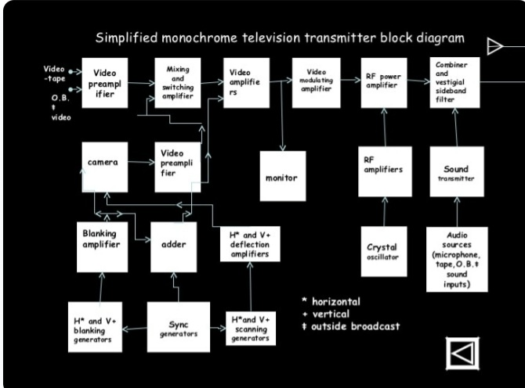
Block Diagram

Slide 7
Working process:
Camera Tubes: video sequence at the transmitting station begins with a transducer which converts light into( video) electric signal.
Video Stage: The function of this switching system is to provide the video controls required.
RF and sound circuitry:Its function is to ensure that,although both the picture and sound transmitter are connected to the antenna with a minimum of loss,neither is connected to the other antenna.

Slide 8
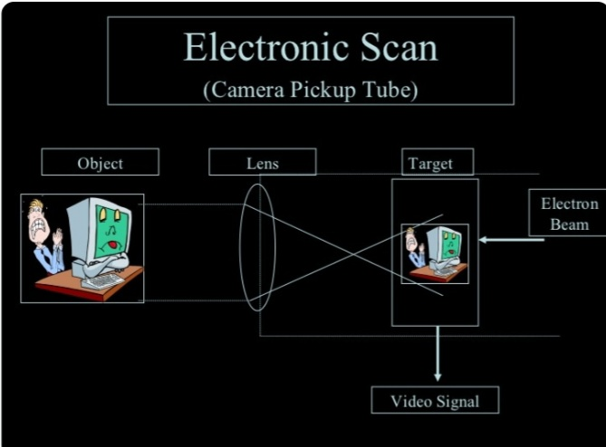
Camera pickup tube:

